Slide 1
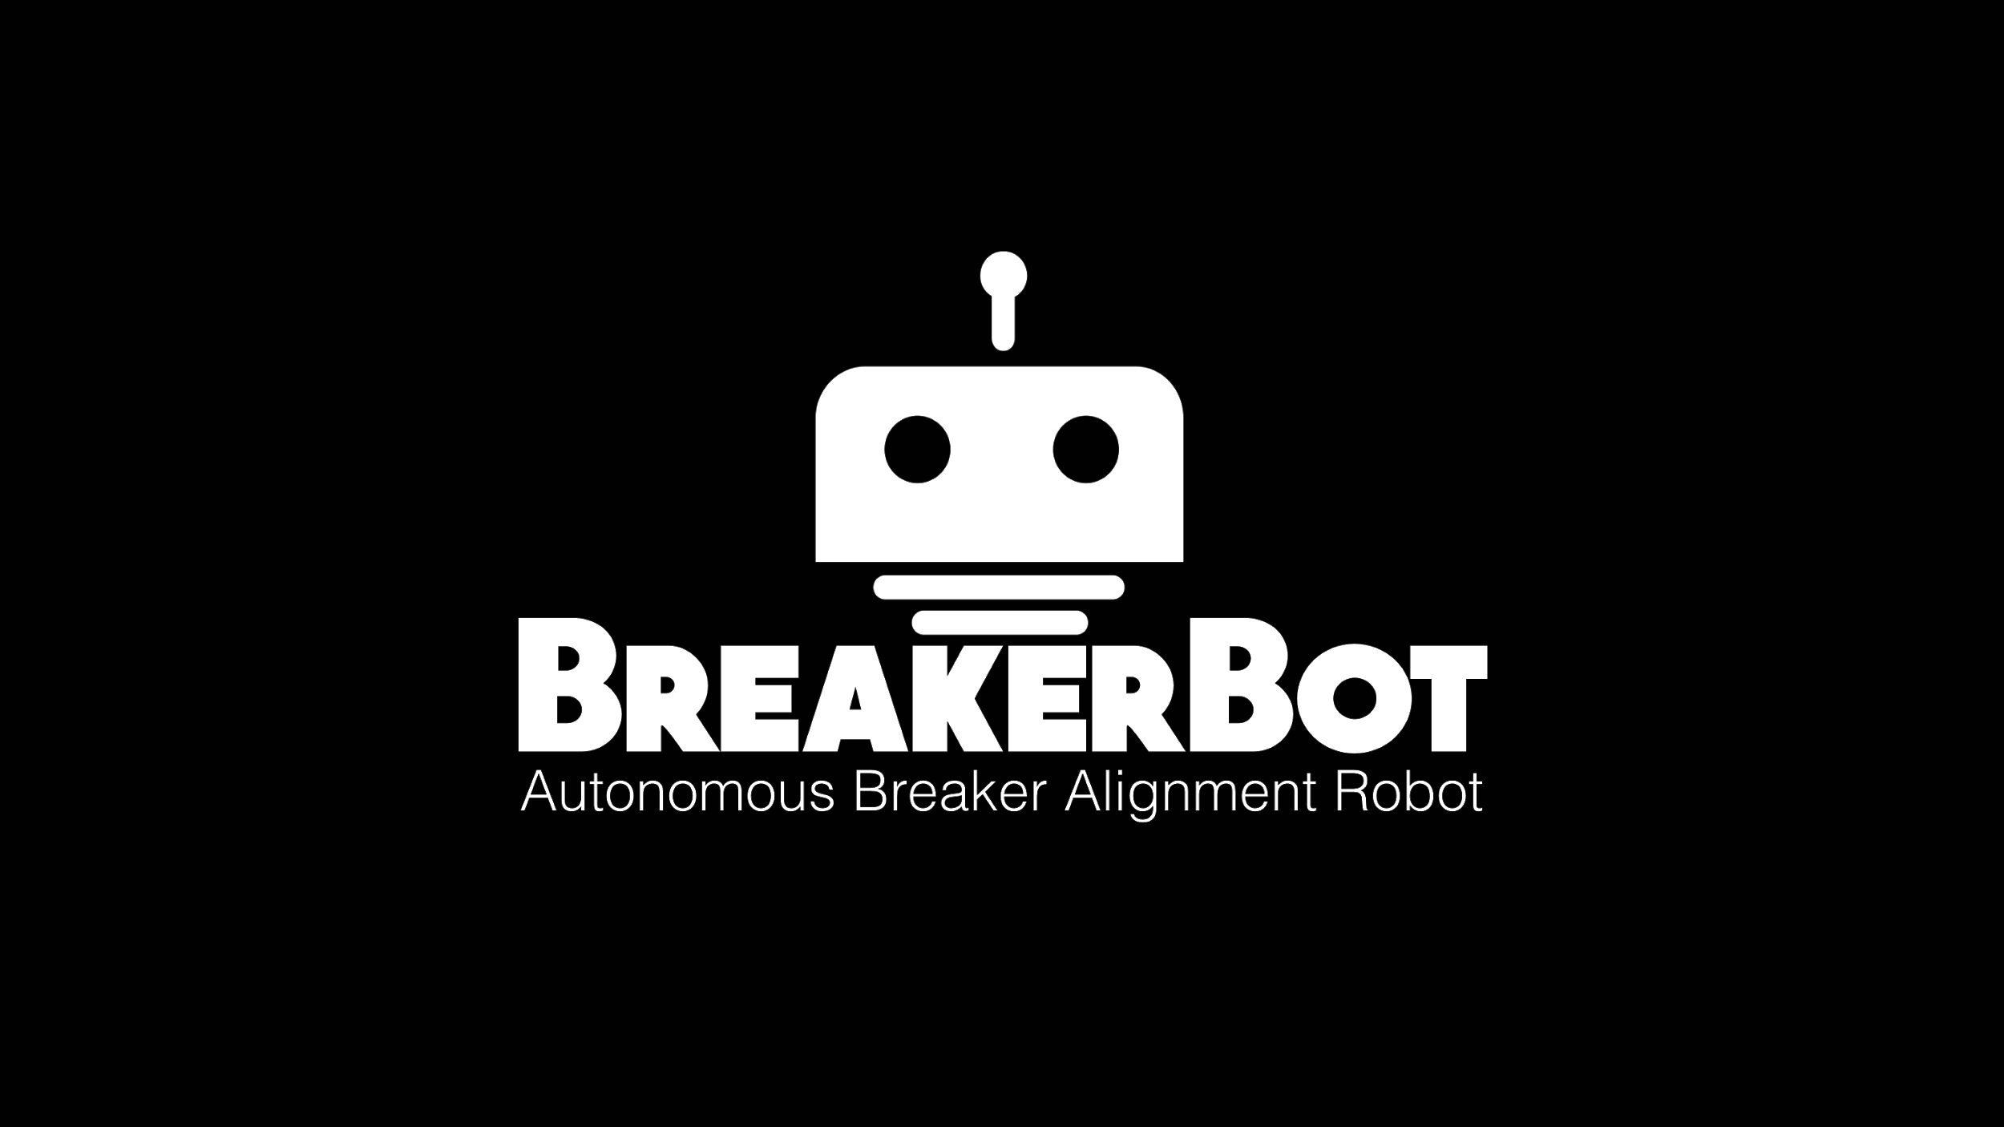

Slide 2
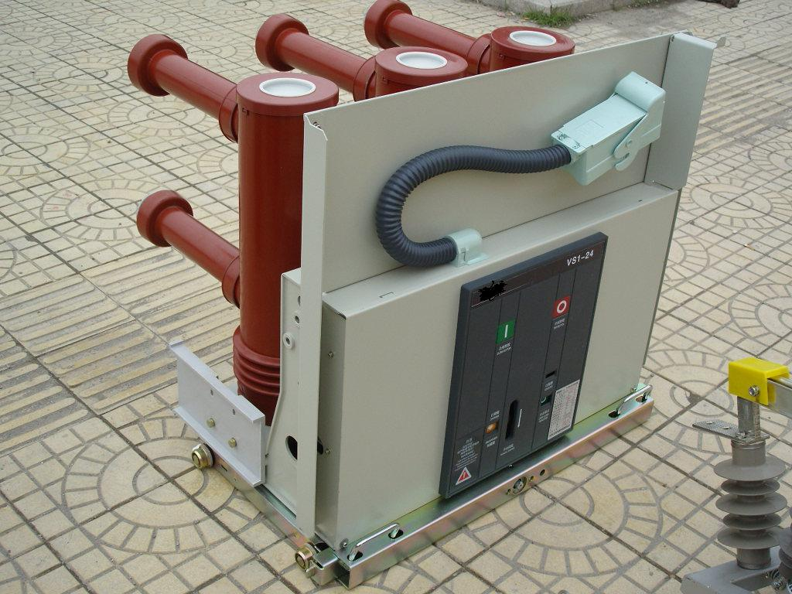
Background
Problem: The insertion and removal of high-voltage circuit breakers is manually intensive and can be fatal if electrical arcs occur. Consolidated Edison, a power company in New York, presented this problem to Boston University.
Goal: Design and construct a robot to automate and optimize this process and reduce the danger to employees.
Customer: ConEdison
13.8 kV Circuit Breaker
Notes:
The problem we are trying to alleviate is that in power substations all over the world utilize circuit breakers to protect their customers from excessive current draws and short circuits. Currently replacing these circuit breakers for maintenance or testing is dangerous, because of possibilities of arc flashes due to the high potential inside of the cabinets. In addition to that they are on the scale of 800 pounds and due to this heavy weight and the geometry, are very difficult to maneuver.
Consolidated Edison (ConEd) approached Boston University to design an automated process to replace circuit breakers while keep employees out of harm’s way and that’s exactly what BreakerBot does

Slide 3
Members
Neeraj Basu
Electrical Engineer
Pete Benja
Computer Engineer
Paul Gennaro
Mechanical Engineer
Daniel Gorelick
Computer Engineer
David Miller
Mechanical Engineer
Carolyn Nicolo
Mechanical Engineer
Emily Stern
Mechanical Engineer
Alex Wong
Computer Engineer
Notes:
This is…
We are an interdisciplinary team between the ME and ECE departments at BU.
More about this?
There have been a number of challenges with managing a team this large. The main one being communication, it’s not very easy to coordinate meetings with eight college students but we’ve manages to do it anyway.

Slide 4
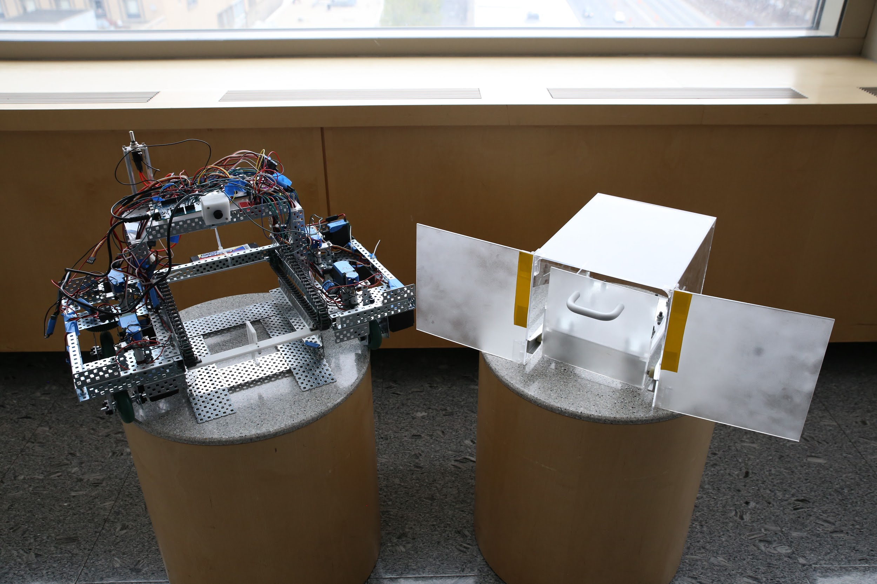
Final Deliverable
Notes:
So our final deliverable to ConEdison is prototype capable of extracting scaled down circuit breakers from their housing cabinets. From the beginning of this project, we knew that this would be a multi phase project that would be take a couple of year to perfect. Therefore for our specific phase of this project, we hope to demonstrate a successful alignment algorithm in order to extract and insert breakers, as well as translate the robot around with the breaker on the body of the robot. Therefore we have completed the first phase and plan to pass this model down for future years to add upon with the ultimate goal of eventually delivering a full sized robot.
Breakerbot offers some unique features in order to complete successful alignment. such as swerve drive steering, which is a holonomic drive system that gives us full control over the direction of each individual drive wheel. These means we can get very precise movements in the x,y,z direction which is crucial for our fine alignment. Very small margin of error
Breakerbot also offers remotes connectivity through a websocket that gives the operation remote control over Breakerbot through a user interface, so they can control it from a safe distance.
So this is the final design of Breakerbot. What your looking at is a prototype robot meant to replace a scaled breaker while still demonstrating the same qualities as the life sized one. The full sized model for this concept was unrealistic within just one year due to budget and time constraints. This project is meant to be a multi year project where we have completed the first phase and plan to pass this model down for future years to add upon. The main purpose of this model was to demonstrate the capabilities of an effective alignment algorithm, insertion/extraction as well as translation with the breaker on the body of the robot.

Slide 5
Technical Overview
Intel Edison Arduino Breakout board
Main control program (C++) for all hardware
Node.js application hosts user interface web application
Sensory feedback
NavX, Potentiometers, Video image processing
Remote monitoring and control
Internet of Things to connect operator with Breakerbot
Operator sends input using Logitech gamepad
Power
System powered by a 5000mAh rechargeable battery
Web application
User Interface
TCP/IP socket
Node.js Application
unix socket
Intel Edison
C++ Control Program
digital/analog signals
Motors, Drive train, and intake system

Slide 6
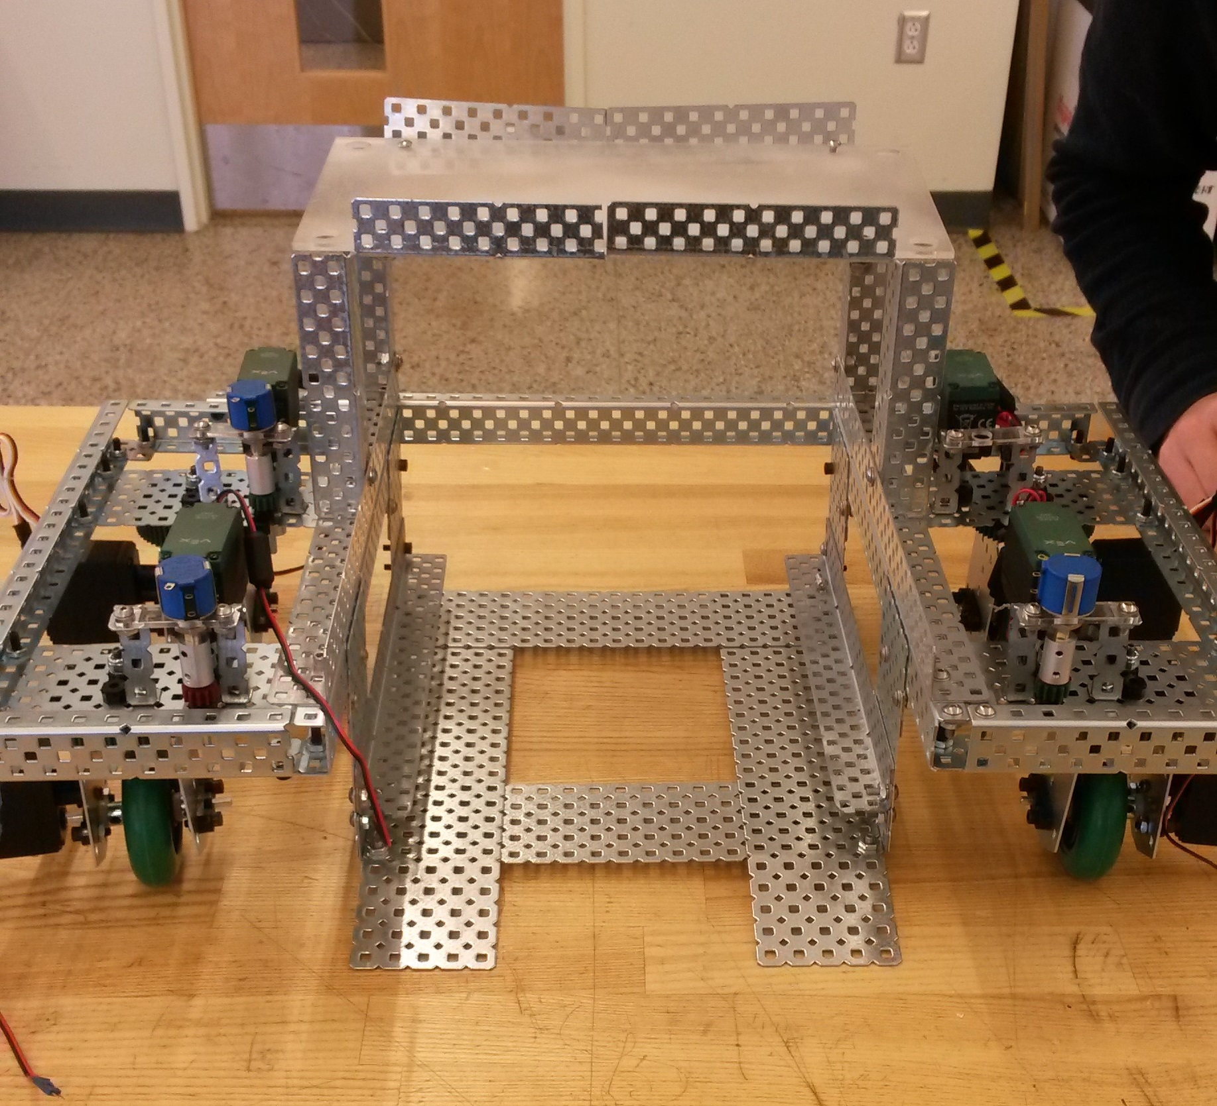
Carolyn Nicolo, Mechanical Engineer
Chassis
Consists of two pods connected by a bridge and a rigid beam
One ramp is connected to each pod to hold the breaker
Pods
Rigid Beam and Bridge
Notes:
The chassis is the foundation of BreakerBot. We decided to construct the chassis from steel vex edr material to allow for ease of construction. It consists of two pods connected by a bridge to support electronics and a rigid beam to connect the pods together. A ramp is connected to each pod to hold the breaker.

Slide 7
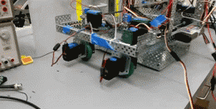
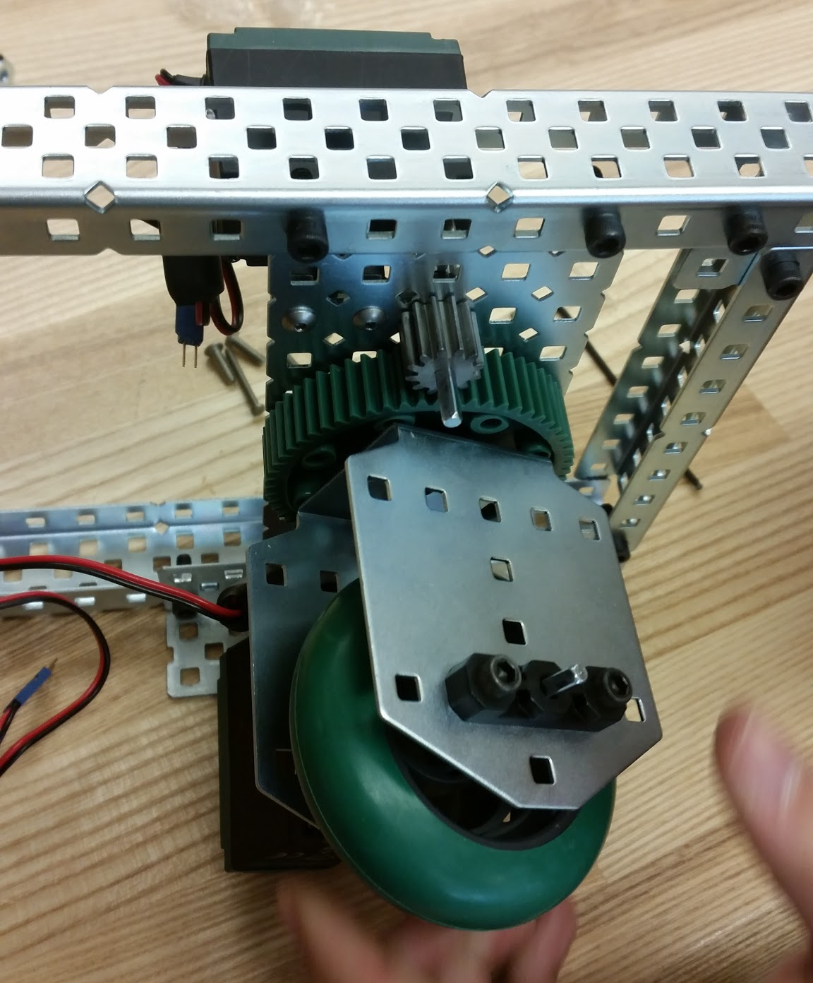
Emily Stern, Mechanical Engineer
Swerve
Allows for holonomic motion
Best of both worlds, agility and torque
Notes:
One of the main functions of the robot is the drive train. THe robot needs to have the ability to translate in the x y plane on the substation floor. This requires the robot to be both agile and powerful, and therefore drove us to choose Swerve drive for our design. Swerve drive has 4 indepently power and steered wheel modules.

Slide 8
Alex Wong, Computer Engineer
Intel Edison
500MHz dual-core Intel Atom
Hardware/software integration with external hardware
I²C
PCA9685 I²C-PWM 16-channel controller
NavX MXP Gyro-Accelerometer
Analog: Bourns 10-turn potentiometers
Wireless: 802.11n Wi-Fi
Swerve Drive Integration
Rotational feedback (Bourns 10-turn potentiometers)
Motor control and calibration
Enables 3-axis translation

Slide 9
Daniel Gorelick, Computer Engineer
Control Program
C++ object oriented program
Separate software modules for each piece of hardware
User interface
Angular framework to render live data feed on the view
60 FPS loop receives input from operator via Logitech gamepad
Inter Process Communication
Unix socket between Node.js and C++ programs
TCP/IP socket between Node.js and web application

Slide 10
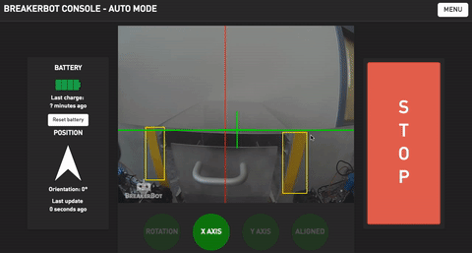
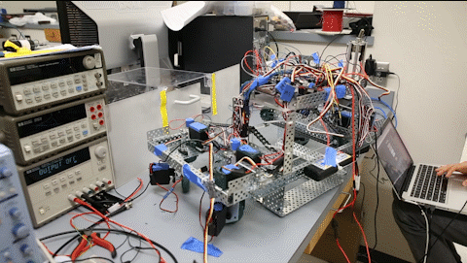
Pete Benja., Electrical and Computer Engineer
Alignment Algorithm, Three-Stage Alignment
Stage 1: Rotational Alignment on the Z-axis
Stage 2: Distance away from the cabinet along the Y-axis
Stage 3: Horizontal Alignment along the X-axis
All three must be satisfied for the robot to be perfectly aligned
Sensory Feedbacks
USB Camera Module for X and Y (colored image-detection)
NavX Gyro Accelerometer for Yaw (deviation from zero degree)
Notes:
One of the major goals for this project is for the robot to autonomously align with the breaker cabinet. The alignment process is done in 3 stages. First, the robot receives a sensory input from the NavX Gyro Accelerometer, from there it corrects its Yaw or the Z-axis rotation, to be parallel with the face of the cabinet. In the second and third stages, the robot utilizes the camera input via image-detection. Looking for the two yellow markers on each sides of the cabinet, the robot will move forward, backward, left or right based on its current position and the desired position.

Slide 11
Neeraj Basu, Electrical Engineer
Battery Features
7.2V, 5000mAh rechargeable NiMh battery
Optimize Run Time
Electrical Safety Protection
4A In-Line Fuse
Emergency Toggle Switch
Wire Gauge Selection
Power Compatible Components
Communication with sensors and motors
I²C rails for communication with sensors and motors
Notes:
Appropriate operating voltages
Finally all communication was handled through rails allocated for I2C lines. The SDA and SCL lines are connected to their appropriate devices through these rails, allowing for successful communication throughout the entire system.

Slide 12
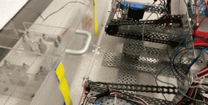
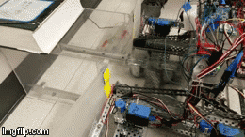
Paul Gennaro, Mechanical Engineer
Design
Passive hook rides along chain powered by single motor
How it works
Arm comes underneath to pull breaker onto robot
Arm pushes breaker into cabinet
Chain pulled taut for control
Rails ensure proper alignment
Notes:
To push and pull the breaker onto and off of the robot, we designed a system to use the fewest number of actuators as possible, to ensure reliability and minimize complexity. We designed a passive hook, which rides along the a chain powered by a single. As the hook rounds the front of the chain it attaches to the breaker, pulls it up a ramp and onto the robot’s center of mass.

Slide 13
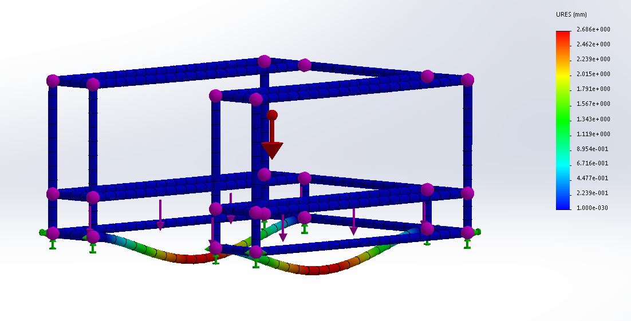
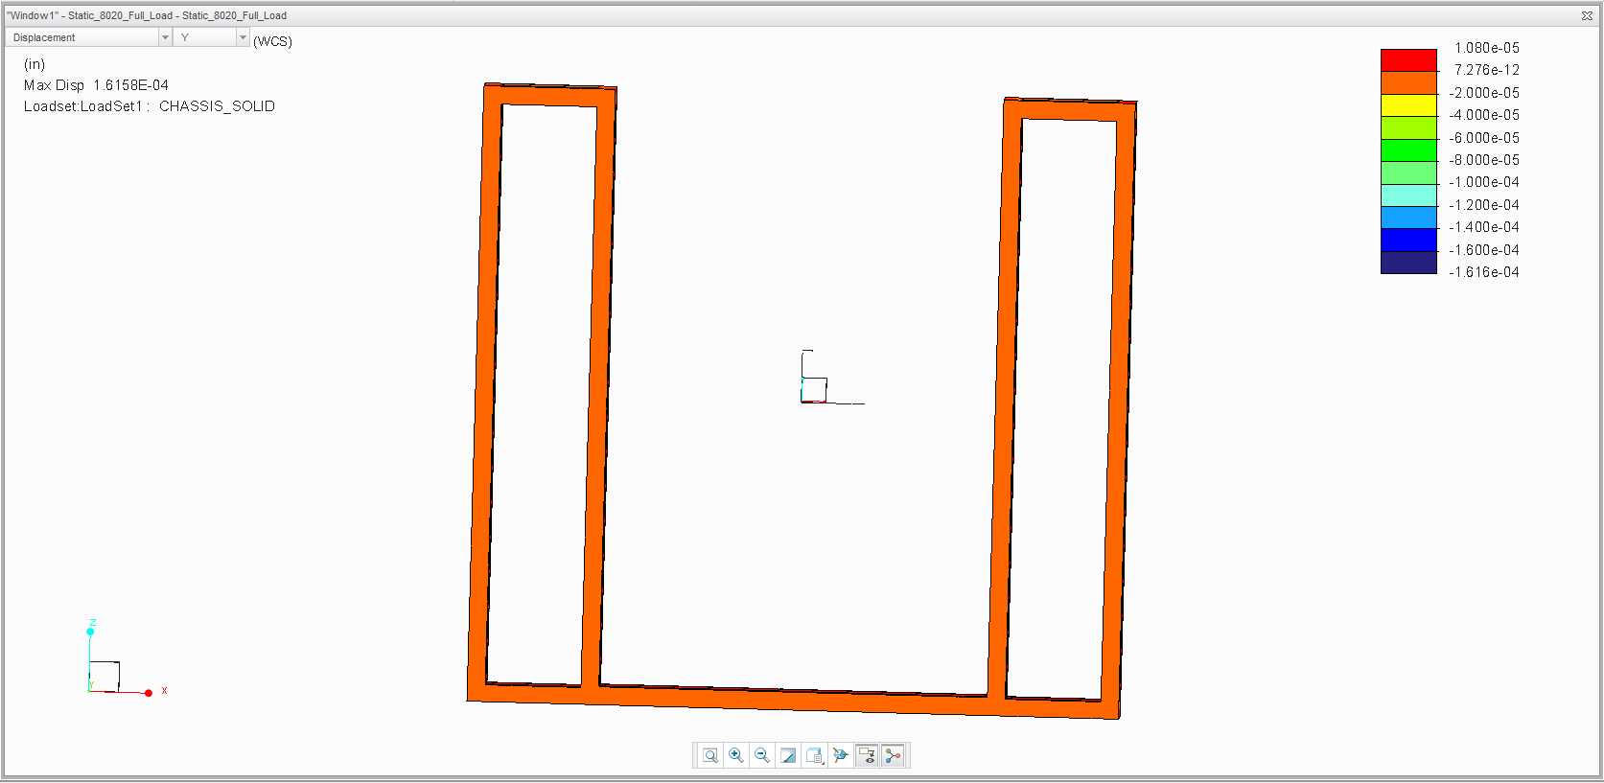
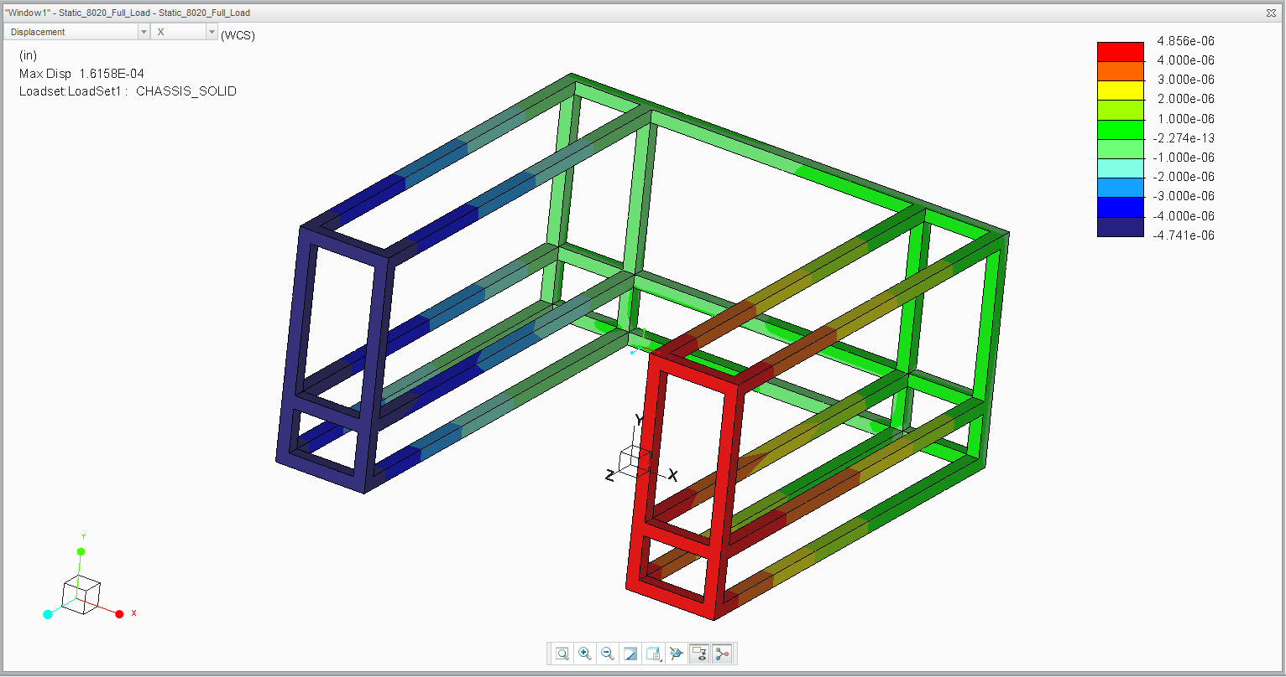
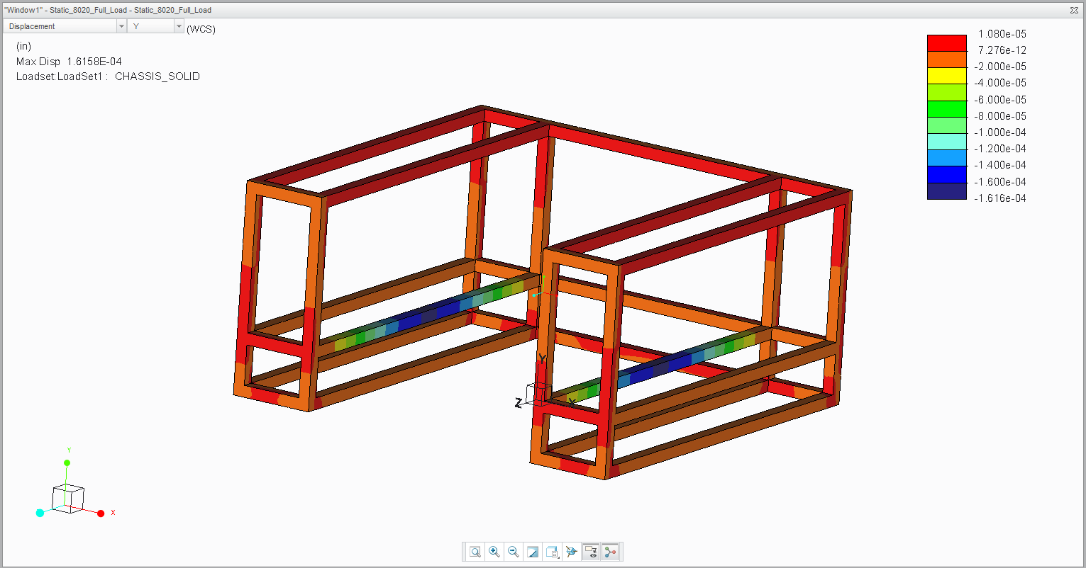
David Miller, Mechanical Engineer
Scalability
FEA on full scale design
Kinematics equations
Notes:
We designed our robot prototype with scalability in mind. We performed FEA analyses on the chassis in order to ensure our design could support the 850lb load of the breaker. The inverse kinematics required for control and alignment of the robot are also scalable to the full sized robot.

Slide 14
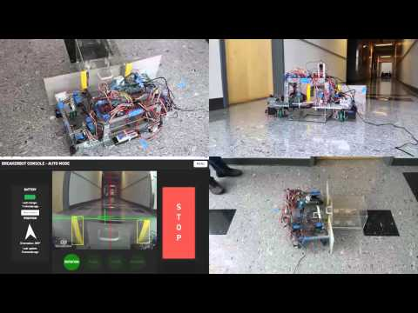
BreakerBot Demo
Demo Video

Slide 15
Concluding Remarks
Automation to the electrical utilities industry
Improves efficiency
Removes hazards for operators
Proof of concept is complete, future teams can develop:
Full-scale robot which can work with 850lb breakers
Completely autonomous driving and alignment
Individual breaker cabinet detection (using RFID tags)

Slide 16
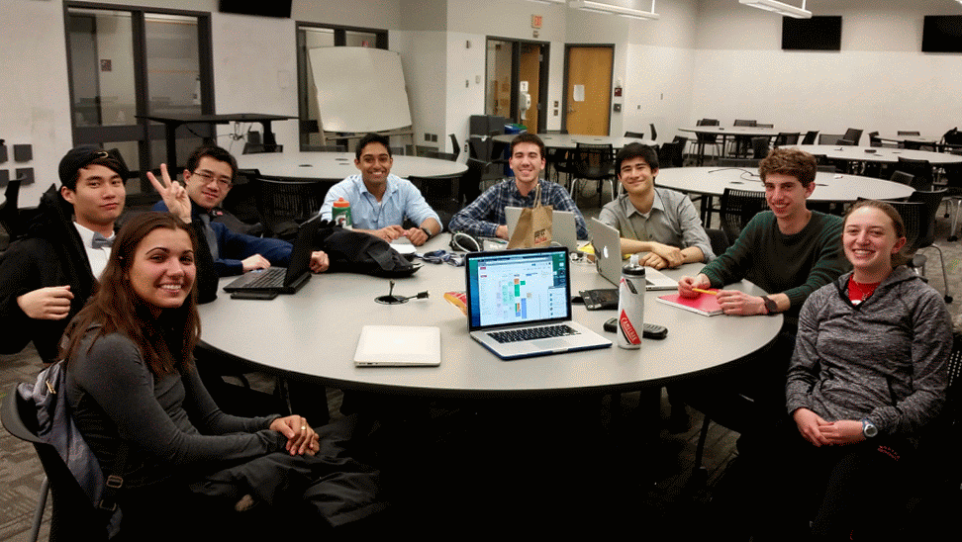
Teamwork makes the dream work!
Notes:
Emily: The ultimate goal of senior design is to learn; we learned numerous technical skills, including robotics, refining customer expectations, and societal engineering, but perhaps most important lesson we learned was the value of teamwork.

Slide 17
Questions?

